Slide 1
9/17/15
QOD: What is the difference between a covalent bond and an ionic bond? #TBT
LG1 :Understand how water supports life.
LG2 : Understand the pH scale and how relates to acids and bases.

Slide 2
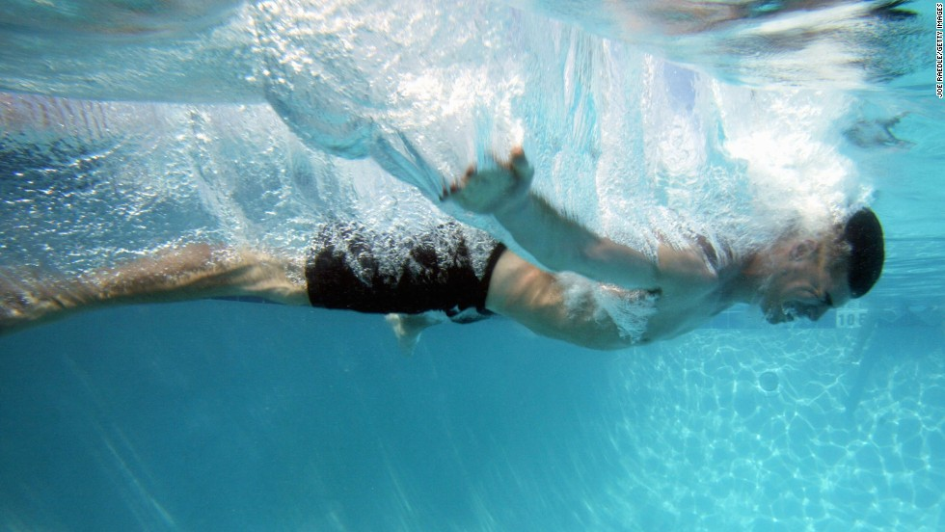
Properties of Water

Slide 3
Water is the strangest, yet most common, molecule on earth! Its strangeness is due to its chemical structure and its chemical properties. Its properties are required for life. Water covers about 70% of the earth’s surface, and it comprises about 70% of our body mass.

Slide 4
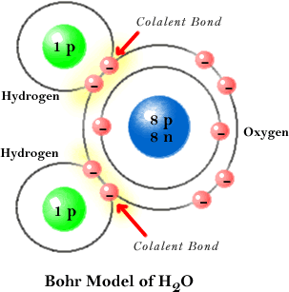
Water = H₂O
Oxygen and Hydrogen are bonded together by Covalent Bonds
O and H share some electrons

Slide 5
Water is a Polar Molecule
POLAR COVALENT BONDS – unequal sharing of electrons; creates molecules that have a slightly positive pole and a slightly negative pole
Water is a Polar Molecule
Oxygen atom is bigger than Hydrogen atoms.
Oxygen has 8 protons
Oxygen pulls the electrons closer, making the oxygen side of the molecule partially negative and the hydrogen side partially positive

Slide 6
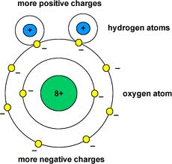
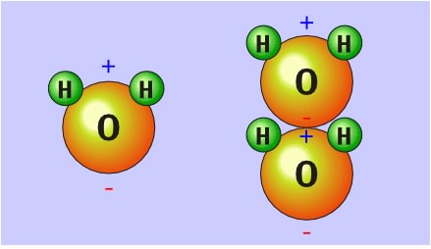

Slide 7
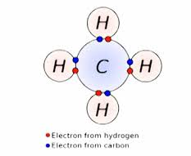
NON POLAR COVALENT BONDS – EQUAL sharing of electrons

Slide 8
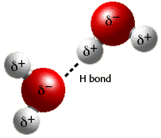
How does water stick together?
The positive end of one water molecule attracts the negative end of another water molecule, until all the water molecules are connected.
The “connections” between different water molecules are called Hydrogen Bonds- A weak attraction between the slightly negative oxygen of one molecule, and the slightly positive hydrogen of another
OPPOSITES ATTRACT!!

Slide 9
Water is a polar molecule because
It shares electrons equally between oxygen and hydrogen
It shares electrons unequally between oxygen and hydrogen
It freezes at zero degrees Celsius
It forms ionic bonds with other water molecules

Slide 10
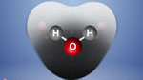
Which side of the water molecule has a slight negative charge?
Oxygen side
Hydrogen side
Darker grey shading shows higher electron density around nuceli

Slide 11
What type of bond exists where the red arrows are pointing?
Ionic
Covalent
Metallic
Hydrogen

Slide 12
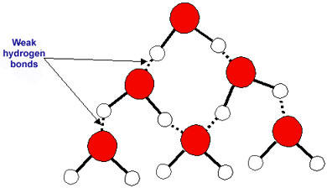
Water molecules form what type of bonds with each other?
Covalent bonds
Metallic bonds
Ionic bonds
Hydrogen bonds
These weak bonds
saburchill.com

Slide 13
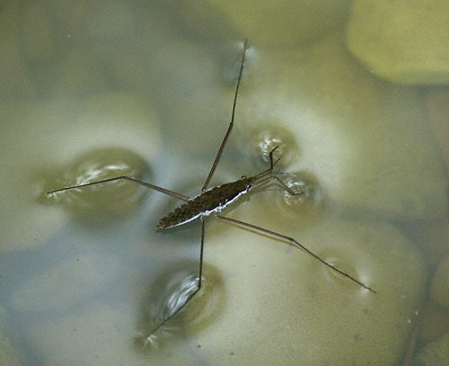
Cohesion
Cohesion: attraction between molecules of the
same substance. Water likes Water.
Water is cohesive because the H-bonds hold the molecules together. Cohesion of water molecule creates high surface tension.
A paper clip can float in water and insects can walk on water because the H-bonds hold the water molecules together
Water strider

Slide 14
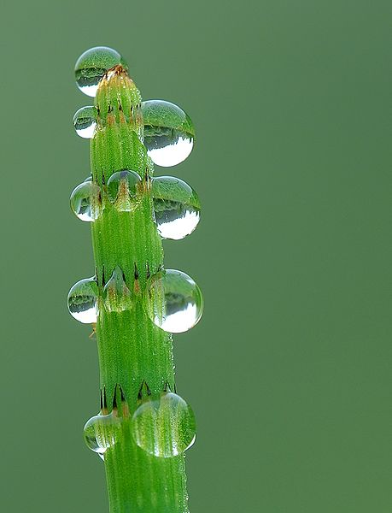
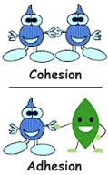
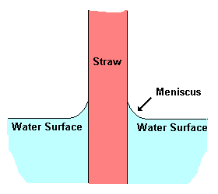
Adhesion
Adhesion: attraction between molecules of different substances. Water loves some other substances too.
Examples:
Meniscus in graduated cylinder: water sticks to the glass and “crawls up”
Water sticking to the leaf of a plant

Slide 15
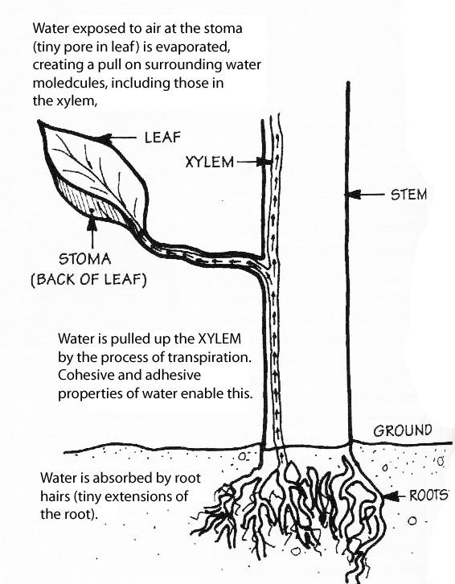
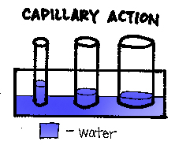
Capillary action: water moves up thin tubes
Adhesion and cohesion
cause capillary action
Water moves up in plants
from the roots to the leaves
though tubes called xylem.
The thinner the tube, the higher
the water moves.

Slide 16
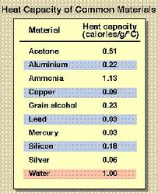
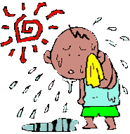
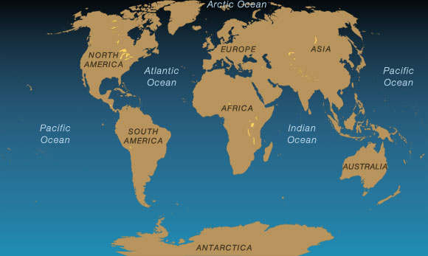
Heat Capacity (specific heat)
Water has a HIGH heat capacity! It takes a lot of heat energy to raise the temperature of water!
Water absorbs the heat produced by cell processes and regulates the temperature of the cell
The lakes and oceans on Earth help to stabilize temperatures because so much heat is absorbed by water

Slide 17
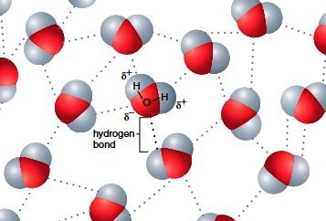
Water droplets form by water molecules being attracted to each other. What term best explains this behavior?
Adhesion
Cohesion
Solubility
Magnetism
encyclopedia.lubopitko-bg.com

Slide 18
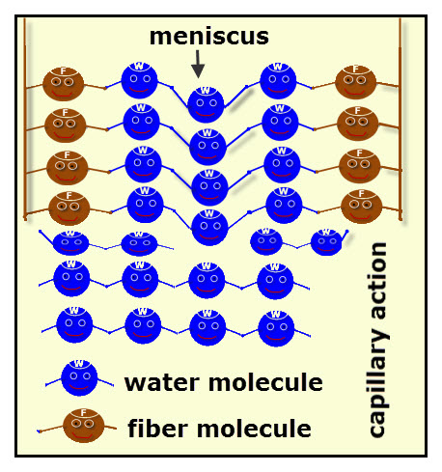
Which property of water allows water to stick to the sides of the straw?
Cohesion
Adhesion
Heat capacity
Universal Solvent
Straw molecules
scienceprojectideasforkids.com

Slide 19
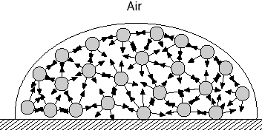
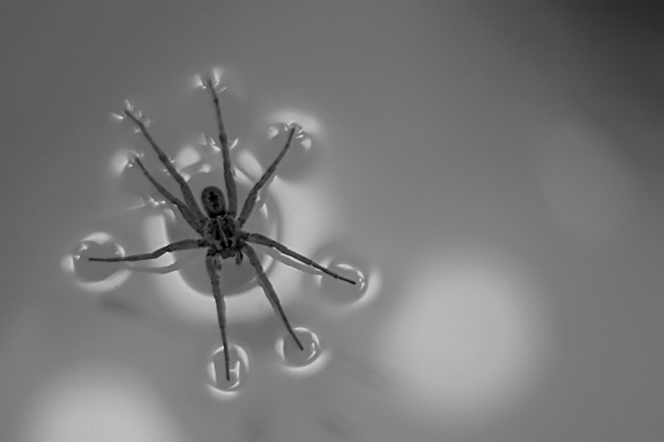
Which property of water allows bugs to walk on water?
Adhesion
Surface tension
Heat capacity
defneapul-cive1170.wikispaces.com
quest.nasa.gov

Slide 20
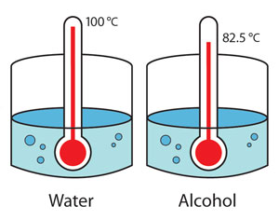
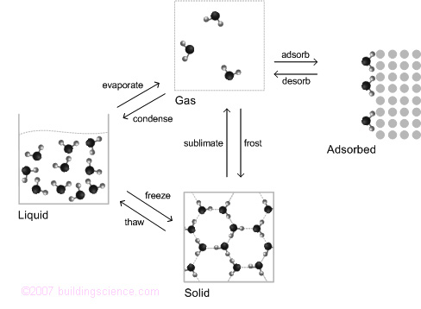
Water takes _______ heat to change to its gaseous state.
Large amounts of
Small amounts of
No
Boiling temperatures
buildingscience.com
Middleschoolscience.com

Slide 21
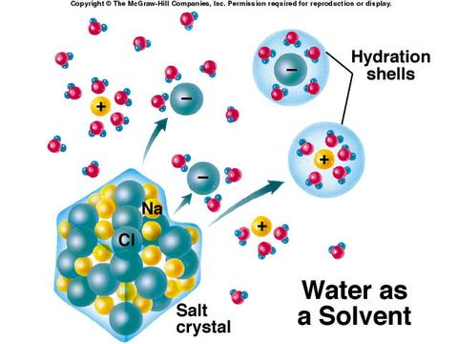
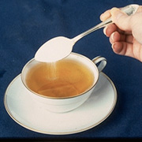
Universal Solvent
Water dissolves most substances!
Water dissolves polar substances. Water cannot dissolve nonpolar substances.
Like dissolves like!!
Water inside the cells and body can carry
nutrients and waste around.

Slide 22
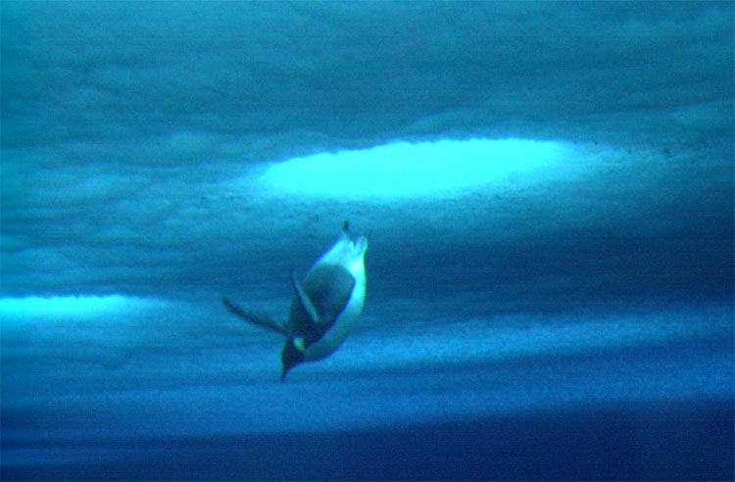
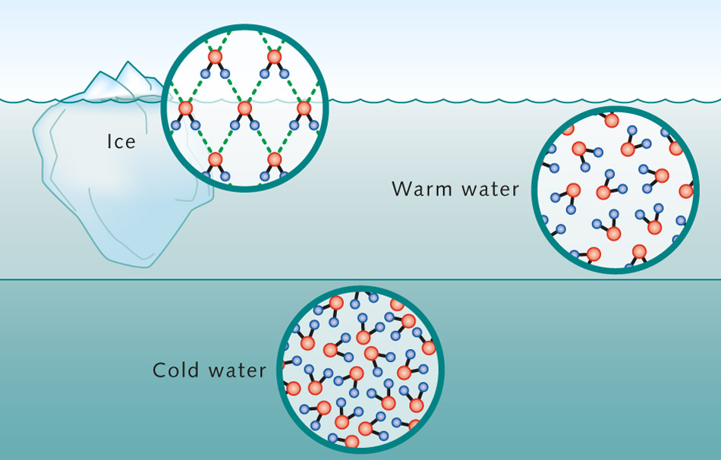
ICE IS LESS DENSE THAN LIQUID WATER
Solid water (ice) is less dense than liquid water and floats.
Water expands when it freezes - Ice floats.
Floating ice prevents rivers, lakes, and oceans from freezing solid.
The top ice insulates the water below from the extreme cold.

Slide 23
What property of water allows sweat to cool the body & coastal cities to have more stable temperatures than inland cities?
High heat capacity of 1.0 calories/gº C
Neutral pH of 7
Surface tension and capillary action
Living Solvent of polar covalent & ionic compounds
Very helpful animation to explain:
http://www.hk-phy.org/contextual/heat/tep/temch/island_e.htm http://www.abpischools.org.uk/page/modules/skin/skin3.cfm

Slide 24
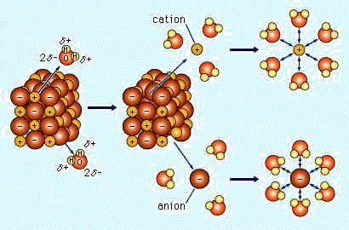
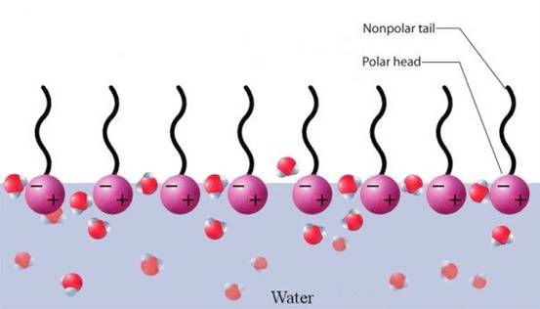
What kinds of substance can dissolve in water?
Hydrophobic/nonpolar molecules
Hydrophilic/polar molecules
http://chsweb.lr.k12.nj.us/mstanley/outlines/waterap/water.html newdirections.com.au

Slide 25
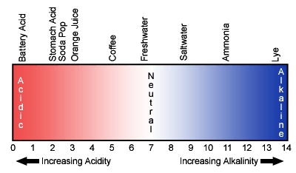
pH: 0 -14
pH: A measure of a solution’s acidity or alkalinity (basic)
pH scale: 0-14
0 = Very Acid 14= Very Basic
Pure Water is neutral.
0-6 ACID 7 NEUTAL 8-14 Base

Slide 26
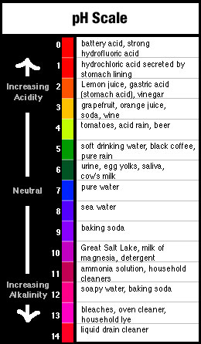

Slide 27
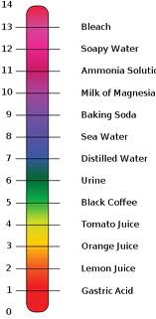
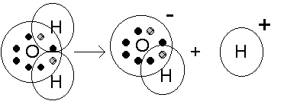
pH Scale
Acids are substances that have
a higher H+ ion than 0H-
concentration.
Bases are substances that have
a higher OH- ion than H+
concentration.

Slide 28
A solution with a pH of 3 is
Acidic
Basic
Neutral

Slide 29
A solution with a pH of 8 is
Acidic
Basic
Neutral

Slide 30
Which of the following is considered a basic solution?
H⁺ is greater than OH⁻
OH⁻ is greater than H⁺
H⁺ is equal to OH⁻

Slide 31
Which of the following is considered a neutral solution?
H⁺ is greater than OH⁻
OH⁻ is greater than H⁺
H⁺ is equal to OH⁻

